Slide 1

qi23_07: Transparency, Security and Immutability of Electoral Process in Ghana using Classical and Quantum Blockchain Technology
Mentor: Peter Nimbe
Presentation by QInterns: Emmanuel Adjei Domfeh and Tayyab Yahya
Full List of QInterns: Emmanuel Adjei Domfeh, Tayyab Yahya, Emmanuel Tapany Junior, Isaac Kwame Ngula Batun, Nicodemus Songose Awarayi, Jacob Mensah, Yousra Ishfaq, Richard Asiamah
August, 2023

Slide 2
Table of Contents
Introduction
Method
Results
Conclusion and Future Works
References

Slide 3
Introduction
The electoral process in Ghana has been susceptible to errors as a result of many human elements, calculations, non-vigilance from one level of the electoral process to another.
In this project, we seek to propose a blockchain framework for the design and implementation of a classical blockchain with quantum encryption for parliamentary and presidential election results submission process in Ghana.
Despite the potential applicability of blockchain technology in the whole electoral process, the primary focus of this project is on the election results submission after close of polls.
The objectives of the project include;
optimizing the results submission and collation process at the polling station, district, constituency, regional and national levels
ensuring the security and integrity of data, pink sheets and other relevant documents.

Slide 4
Quantum Blockchain Technology for National Elections Management
Quantum blockchain technology represents a convergence of quantum computing and blockchain, holding the potential to revolutionize various sectors, including the critical area of national elections management (Azhar & Iqbal, 2019; Bonneau et al, 2015; Dang & Qin, 2020; Govindaraj & Prasad, 2019).
By combining the cryptographic security of blockchains with the computational power of quantum computers, quantum blockchain technology offers enhanced security, efficiency, and transparency for managing national elections (Azhar & Iqbal, 2019; Bonneau et al, 2015; Dang & Qin, 2020; Govindaraj & Prasad, 2019).
Enhanced Security, Verifiable Voting, Privacy & Anonymity, Fraud Prevention, Decentralization & Trust (Azhar & Iqbal, 2019; Bonneau et al, 2015; Dang & Qin, 2020; Govindaraj & Prasad, 2019).

Slide 5
History of Ghana’s Elections & Challenges
The Fourth Republic of Ghana began in 1992 after a period of military rule.
2 major political parties : NPP and NDC
Elections organized over the years (Ayee & Debrah, 2020; Gyimah-Boadi & Shapiro, 2008)
Transparency, accountability, and the potential for fraud or manipulation during the collation, monitoring, and evaluation of election results (Gyimah-Boadi, 2018; Osei et al., 2020).
Voter registration
Electoral Violence
Media Coverage
Campaign Finance
Legal Tussles

Slide 6
Features of Ghana’s Electoral System
2 major types of elections; 1) Presidential and 2) Parliamentary
presidential election is held every four years to elect the President who is the head of state and the Commander in Chief of the Armed Forces through the Majoritarian System (Two-Round System) (Electoral Commission, 2023).
Ghana’s parliamentary election is a single-member constituency election held every four years to elect representatives to the National Assembly (Parliament). Members are elected using the First Past The Post (FPTP) system (Electoral Commission, 2023)
Simple majority/First-past-the-post (FPTP) electoral formula determines the winner in the parliamentary election (Electoral Commission, 2023)

Slide 7
Method
Blockchain for Electoral Results Submission
Participants: Polling Agents, Polling Assistants, Verification Officers, EC Officials
Quantum Encryption of data
Data Compression of document and files

Slide 8
Election System Architecture
The election system architecture consists of 2 principal parts; Frontend and Backend
Frontend: Comprises HTML, CSS and JavaScript web interface for data entry or input. This also serves as the layer where data retrieval is done as well as collated results.
Backend: Comprises the distributed database ledger where encrypted data and documents will be stored.

Slide 9
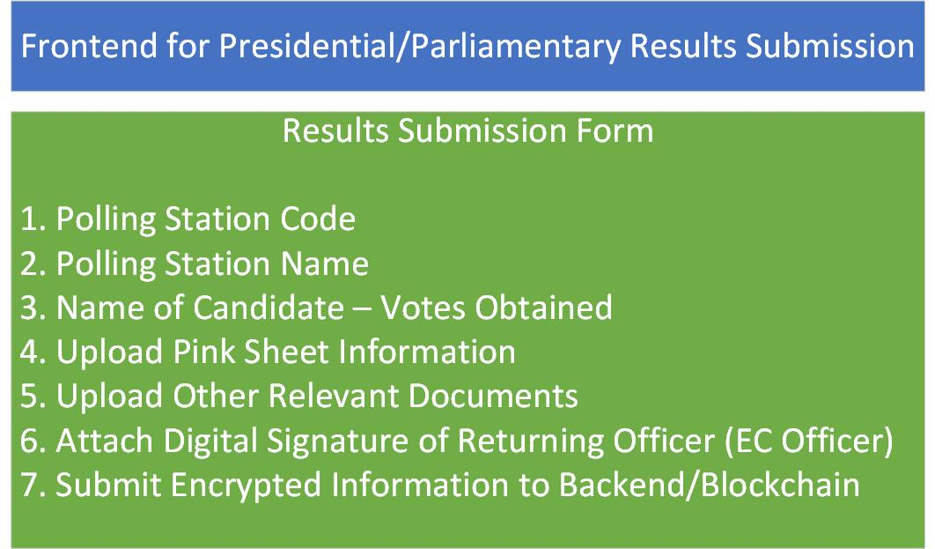
A framework of the frontend architecture with electoral information details

Slide 10
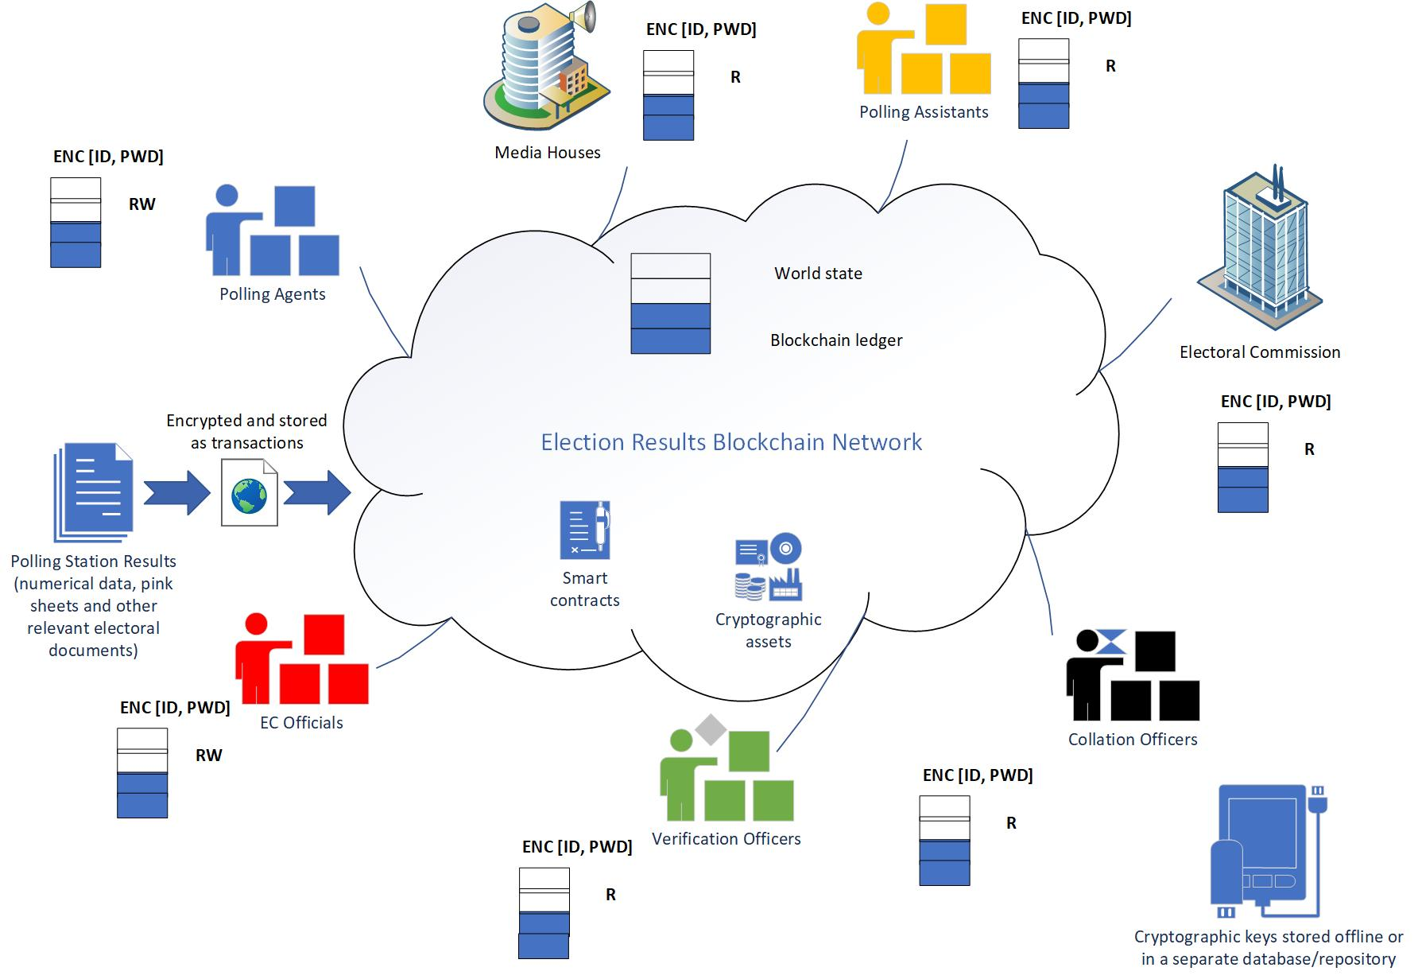
High-level view of the framework of the backend architecture (blockchain)

Slide 11
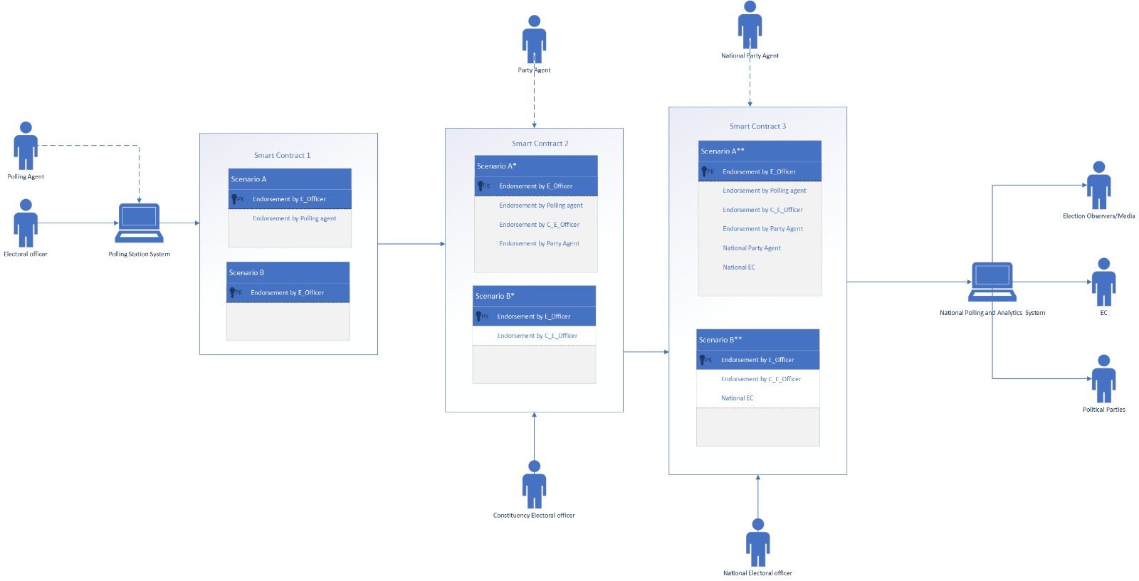
Low-level framework of the backend architecture

Slide 12
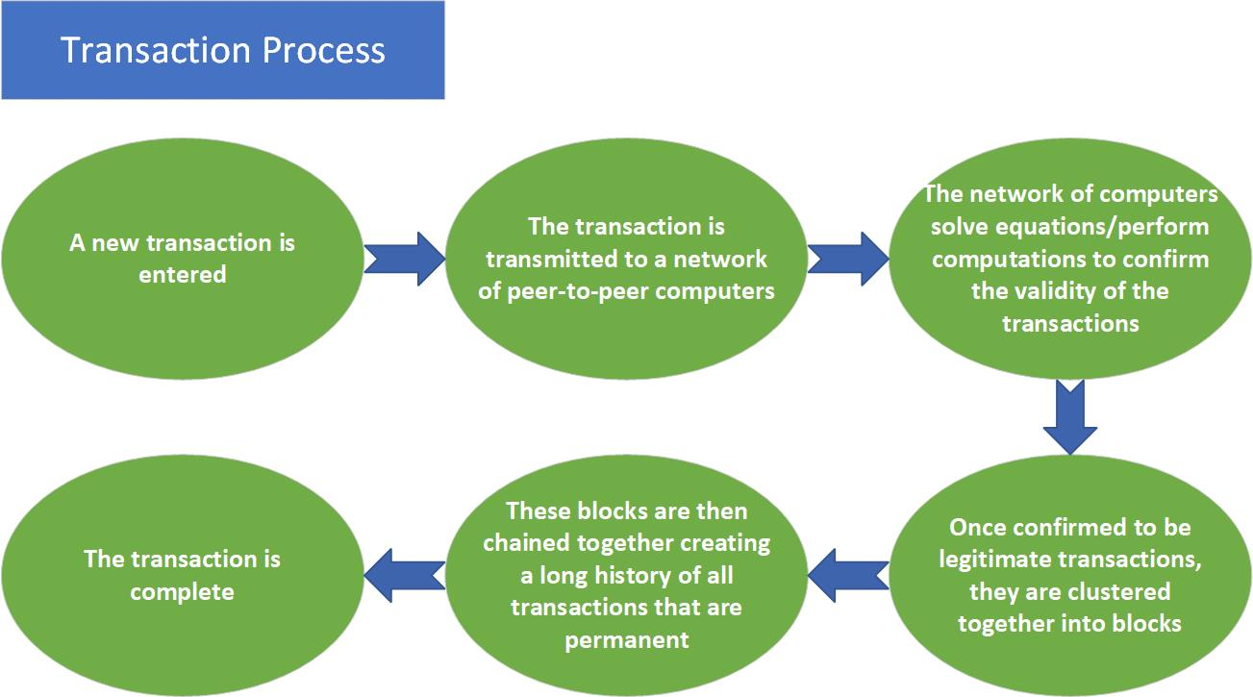
Blockchain transaction process

Slide 13
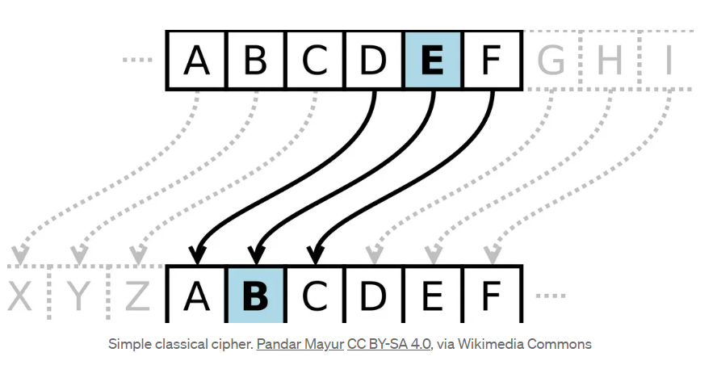
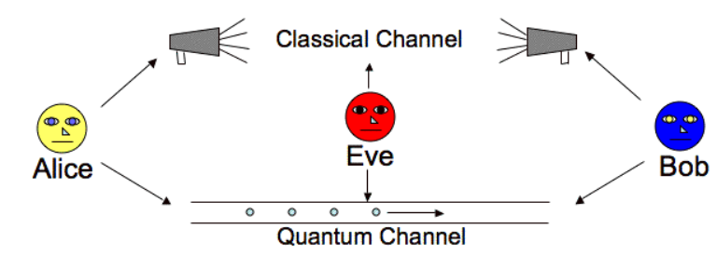
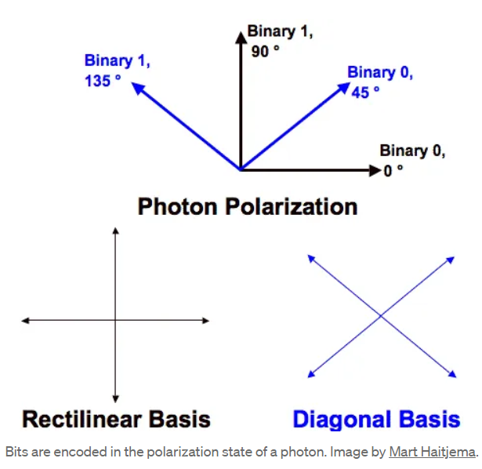
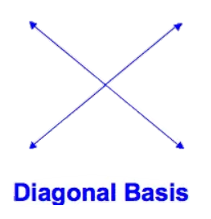
Quantum Encryption and Decryption of data
Cryptography
Classical cryptography
Secret Key Cryptography
Public Key Cryptography
Quantum Cryptography
Heisenberg’s Uncertainty Principle
No Cloning Theorem
Quantum Entanglement
Photons as Qubits

Slide 14
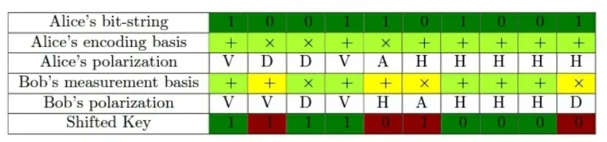
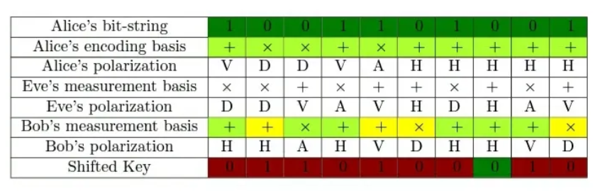
Quantum Encryption and Decryption of data
BB84 Protocol
Eve’s Escape Probability- (3/4)^n times

Slide 15
Quantum Encryption and Decryption of data
Reason for the adoption of the BB84 protocol
more resistant to quantum attacks
allows for the secure exchange of cryptographic keys, which can be used for subsequent encryption and decryption of voting data
can detect the presence of an eavesdropper attempting to intercept the quantum communication, ensuring the integrity of the voting process
rely on the use of quantum randomness, ensuring the generation of secure cryptographic keys
successfully demonstrated over long distances, making it suitable for large-scale online voting systems.
allow for the generation of cryptographic keys offline, reducing the risk of key compromise during the online voting process.

Slide 16
General Steps & Algorithm for Quantum Encryption (BB84 protocol) Using Qiskit
Implement the quantum operations
Implement
basis reconciliation
error correction
privacy amplification
Integrate classical communication
Implement encryption and decryption

Slide 17
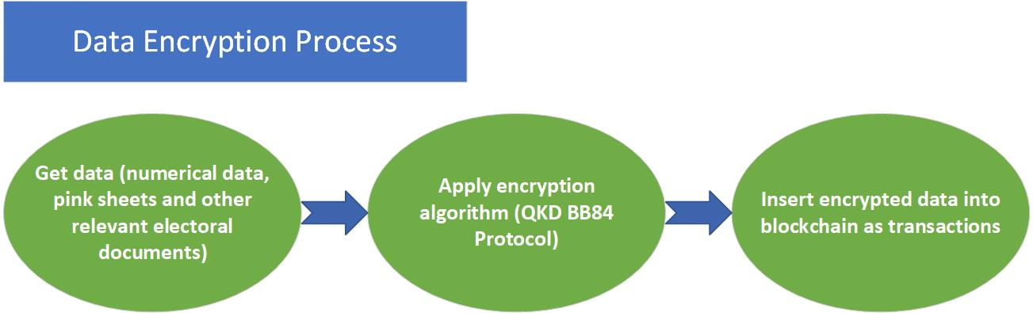
Data Encryption Process

Slide 18
Data Compression of documents and files
Lempel Ziv universal lossless data compression algorithm created by Abraham Lempel and Jacob Ziv is used to reduce the file and image sizes in bits.
The election documents or files include scanned copies of pink sheets, numerical data of presidential and parliamentary elections etc. before they are submitted into the blockchain network.
The need to compress electoral data: Less storage space, Faster writing and reading, Faster file transfer or submission.

Slide 19
Comparison with Traditional Electoral Process
The quantum blockchain approach offers decentralization, transparency, and security, which can improve the process for managing election results and increase trust.
The traditional electoral process, on the other hand, is centralized and may have drawbacks in terms of speed, security, and openness.
The blockchain process optimizes the traditional process in that, there is no multiple results submission at various levels, hence a one-time submission and collation process.
This reduces errors or mistakes that could potentially occur on the collation and multiple results submission processes.
Nevertheless, it is without doubt that a quantum blockchain approach to elections result submission and management would significantly ensure transparency, fairness, credibility and immutability of the electoral process.

Slide 20
Conclusion
Ensures transparent, secure, and credible elections in Ghana
Helps achieves Sustainable Development Goal (SDGs) established by the United Nations
SDG 9 – Industry, Innovation and Infrastructure
SDG 16 – Peace, Justice and Strong Institutions (United Nations, n.d.)

Slide 21
Future Works
Due to the size of this project and huge length of time required, an implementation of the full-scale blockchain with Solidity Programming Language has started but would be completed much later.
In addition cybersecurity requirements would be incorporated in the project
Vulnerability assessments using OpenVAS would be conducted as well to prevent threats and cybercrime.

Slide 22
Github Repository
https://github.com/ptwnimbe1/Ghana-Election-Project-Using-Quantum-Blockchain-Technology

Slide 23
References
Achoribo, R. (2018). Electoral Reforms and Political Stability in Ghana. Journal of Political Sciences & Public Affairs, 6(3), 354.
Ayee, J. R. A., & Debrah, E. (Eds.). (2020). Election 2020 in Ghana: Democratic Consolidation or Stagnation? Friedrich-Ebert-Stiftung.
Azhar, S. M., & Iqbal, J. (2019). Quantum blockchain: A survey. Future Generation Computer Systems, 91, 641-658.
Bonneau, J., Miller, A., Clark, J., Narayanan, A., Kroll, J. A., & Felten, E. W. (2015). SoK: Research perspectives and challenges for Bitcoin and cryptocurrencies. In 2015 IEEE Symposium on Security and Privacy (pp. 104-121). IEEE.
Dang, H., & Qin, S. J. (2020). Quantum Blockchain: A Comprehensive Review. IEEE Access, 8, 21966-21981.

Slide 24
References
Debrah, E. (2018). Political Financing in Ghana: Prospects and Challenges. Journal of African Elections, 17(2), 94-111.
Electoral Commission Ghana. (2023). Electoral System of Ghana. url: https://ec.gov.gh/electoral-system/
Govindaraj, T., & Prasad, S. (2019). A review on Quantum Blockchain. Journal of Physics: Conference Series, 1204(1), 012036.
Gyimah-Boadi, E., & Shapiro, I. (Eds.). (2008). Democracy in Ghana: The 1992 Elections. Oxford University Press.
Quashigah, E. T. (2014). The Electoral Commission and the Management of Elections in Ghana. Journal of African Elections, 13(1), 82-101.

Slide 25
References
Prempeh, H. K., & Gyimah-Boadi, E. (2008). The 2008 Elections and Prospects for Democratic Consolidation in Ghana. Journal of Democracy, 19(4), 103-117.
United Nations. What are the Sustainable Development Goals? (n.d). url: https://www.undp.org/sustainable-development-goals

